Slide 1
SSURGO Download Naming Conventions Background information related to the ‘SSURGO Data Loader’ October 11, 2021

Slide 2
There are several different soils data packages that are currently being created for distribution by our NASIS systems. In this PI there are only two of these that the SSURGO Data Loader might be expected to handle when importing data into a SSURGO-SQLite database. Some of these soil data packages will display differences in the folder and or shapefile naming convention.
The standard SSURGO downloads available from the ‘Download Soils Data’ tab on Web Soil Survey
https://websoilsurvey.sc.egov.usda.gov/DSD/Download/Cache/SSA/wss_SSA_AK600_[2021-09-08].zip
The SSURGO downloads created using batch downloading tools. These tools maintain an older folder-naming convention of ‘soil_<areasymbol>’ instead of the current <areasymbol>. Example: ‘soil_ne109’ vs. ‘NE109’. The only difference from the standard SSURGO download is the parent folder name.
Web Soil Survey AOI downloads are generated by users for smaller areas of interest. Both the folder naming convention and shapefile naming convention for those downloads are a little different. This method is not part of the current MVP but could conceivably be added in the future.
NASIS-SSURGO exports are tabular-only and are for internal users only. This method is not part of the MVP.
Staging Server exports, for internal users only. These SSURGO datasets are similar to the NASIS-SSURGO exports but can include tabular, spatial or both. No spatial or tabular folders are included.

Slide 3
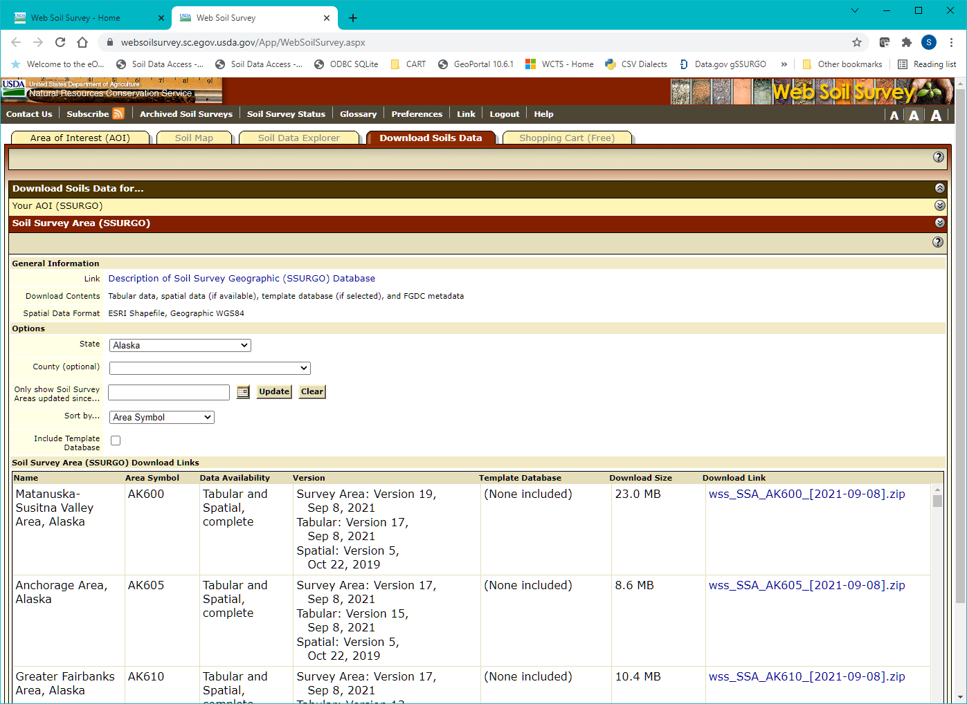
The tradition method for downloading SSURGO data one-at-a-time from the Web Soil Survey on the Download Soils Data tab.
Zipped SSURGO datasets can be downloaded one-at-a-time from the imbedded links on this page (lower right corner of screenshot).
Customers do not have any kind of direct access to the folder containing these data, and there is no batch downloading option available on Web Soil Survey.

Slide 4
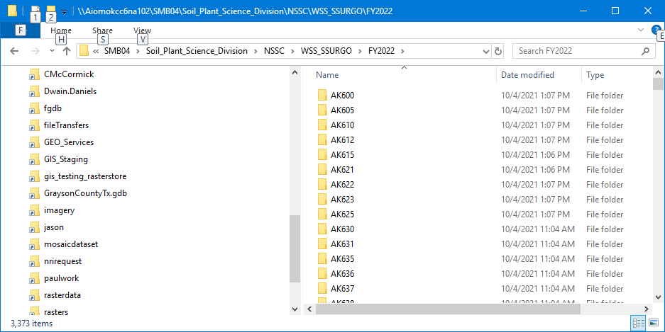
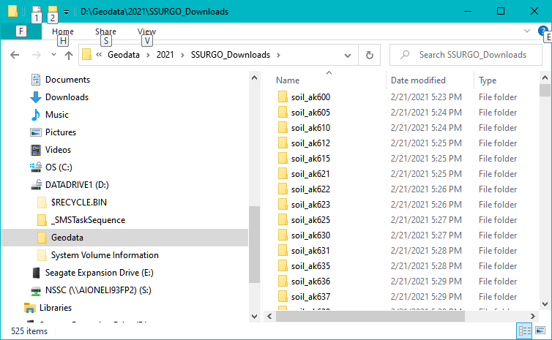
Users downloading SSURGO directly from the Web Soil Survey’s Download Soils Data tab will see the folder-naming convention shown below to the right. The contents of both datasets are the same (spatial and tabular subfolders), only the folder name is different.
We have no way to guarantee which ‘version’ of these SSURGO downloads that folks will have.
To the right is a folder containing SSURGO downloads using the SSURGO Download tools. Please note that the dataset folder names are lowercase and begin with ‘soil_’. These tools are used primarily by state GIS specialists or others who need to download large amounts of soils data.
At some point (2015?), the application that generates the SSURGO downloads was slightly altered. The folder names contained in the downloads dropped the ‘soil_’ prefix and became just areasymbol (uppercase). This changed caused problems for existing tools to automate the download and import process.

Slide 5
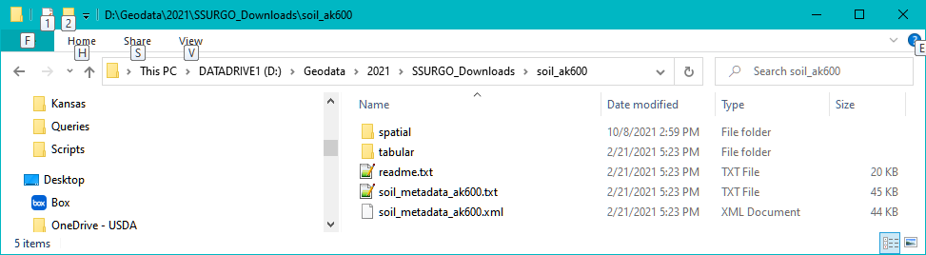
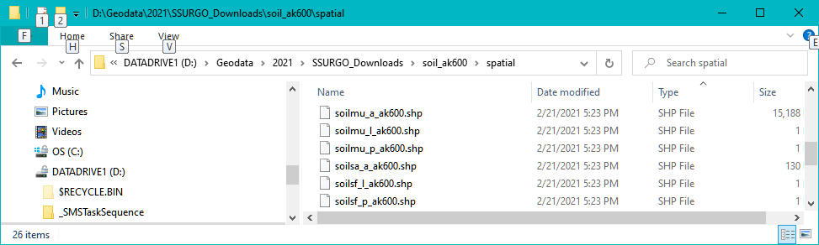
The standard SSURGO dataset consists of:
spatial folder
tabular folder
readme.txt file
FGDC metadata (txt)
FGDC metadata (xml)

Slide 6
The standard SSURGO download from Web Soil Survey consists of:
spatial folder – contains six ESRI shapefiles (WGS 84) and version.txt
tabular folder – contains attribute data in 67 pipe delimited text files plus version.txt
readme.txt file – contains specific content metadata along with general data handling info
FGDC metadata (txt) – required FGDC content metadata for this survey area in text format
FGDC metadata (xml) – same as the text file but in XML format

Slide 7
The spatial folder in a SSURGO export includes the following in ESRI shapefile format:
soilsa_a_*.shp - Soil Survey Area Boundary Polygon
soilmu_a_*.shp - Map Unit Polygons (where available)
soilmu_l_*.shp - Map Unit Lines (where available)
soilmu_p_*.shp - Map Unit Points (where available)
soilsf_l_*.shp - Special Feature Lines (where available)
soilsf_p_*.shp - Special Feature Points (where available)
areasymbol (lowercase)
Please note. The soil survey area boundary and map unit polygon shapefiles must always contain at least one record. Data are optional for the other four shapefiles.

Slide 8
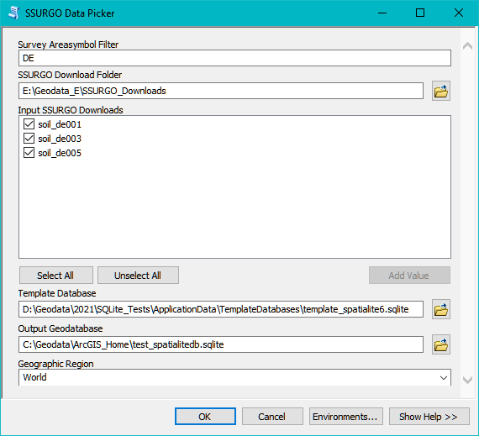
The SSURGO Data Picker would provide the user with a method for assembling the input parameters needed to execute the SSURGO Data Loader.
The SSURGO Data Loader would use information from the SSURGO Data Picker to populate and create a new SSURGO-SQLite database.
SSURGO Data Picker UI
Some of the parameters on the Data Picker such as ‘Survey Areasymbol Filter’ are not passed on to the Data Loader. These type of these ‘other’ filters could vary greatly and require different versions of the Data Picker.
6
SSURGO Data Loader Script Parameters:
Input SSURGO-SQLite database (if external application)
Input Folder (input local folder where unzipped SSURGO downloads reside)
List of folders containing individual SSURGO downloads
Output SQLite database (Data Picker only)
Output coordinate system (EPSG Code, CSR Name). A suggested default value would be ‘EPSG:4326’ and for the initial MVP, this would be the only choice offered.
Survey Areasymbol Filter (Data Picker only)
2
3
1
4
5

Slide 9
The following slides are optional because they cover SSURGO Downloads that are not part of the current MVP.

Slide 10
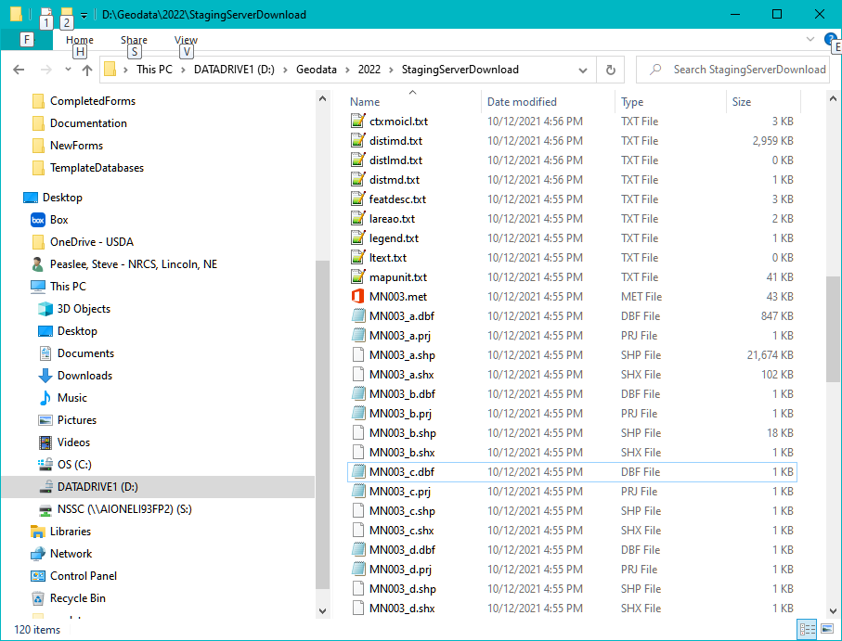
Staging Server exports are generally created for internal SPSD use and not intended for public use.
In this screenshot we can see that the shapefile naming convention does not match the SSURGO specification and there is no spatial-tabular folder.
Another significant difference is that the user can specify that the download consist of spatial or tabular or both.
Not a terribly difficult task to write a data import routine to handle this data structure, but it would take some resources. Do we really need to require support for Staging Server exports in our minimum viable product?

Slide 11
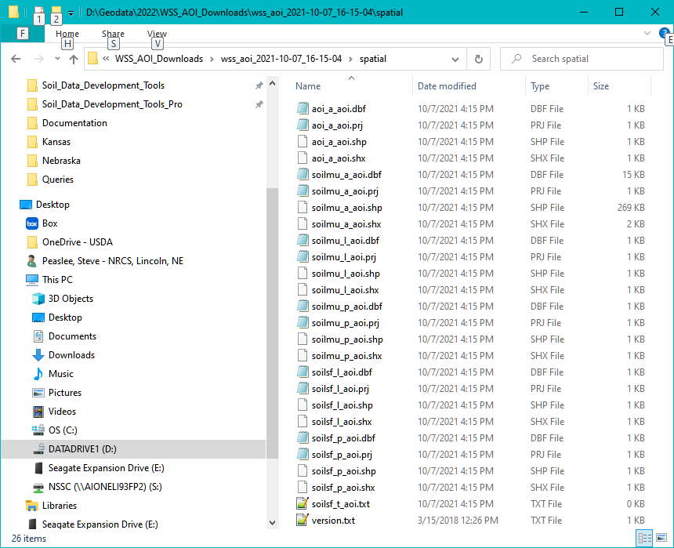
Most of the WSS-AOI Downloads use a similar naming convention as the standard SSURGO shapefiles, but substitute ‘aoi’ for <areasymbol>.
Instead of a ‘soilsa_a’ shapefile for the survey boundary, the WSS-AOI shapefiles will include a shapefile named ‘aoi_a_aoi.shp’ which represents the boundary of the AOI. This shapefile does not have the same column names as the ‘soilsa_a’ shapefile and more specifically does not contain an <areasymbol> column in the attribute table. This is an important issue.
Changes to the Data Loader would be required in order to import the WSS-AOI datasets.

Slide 12
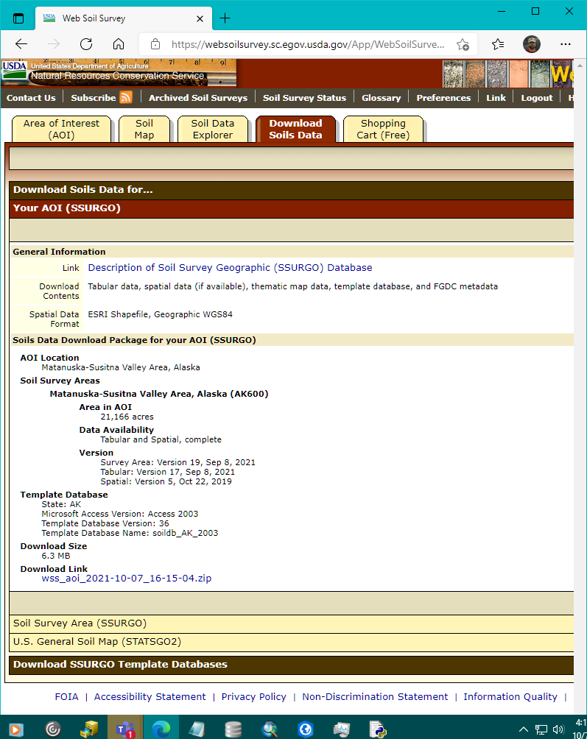
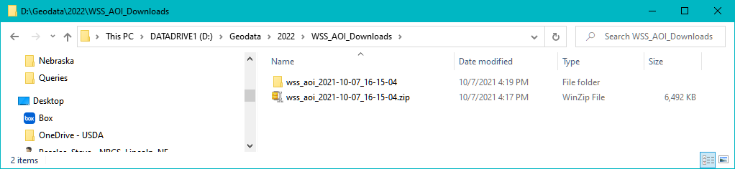
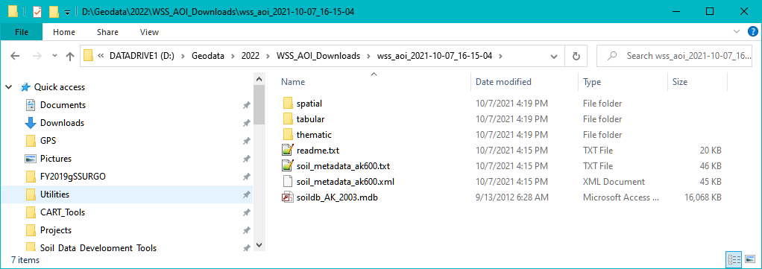
SSURGO downloads generated for an AOI in Web Soil Survey will have a different folder-naming convention as well as a different shapefile-naming convention.
The WSS-AOI downloads do not incorporate <areasymbol> in the folder names. All folder names have a prefix of ‘wss_aoi_’.
The spatial folder and tabular folder contain the standard SSURGO tabular and spatial folders. The next slide show shapefile names.

